Slide 1
Math analysis
Day 26

Slide 2
Objective
Finish Summative Assessment:
Use all function calls (besides offsets, unless you want to)
Create a pattern, submit, and then finish someone else’s pattern… submit
Codecademy

Slide 3
Saving Your ORIGINAL Pattern:
In Bricklayer Lite Level 3
Save your object as Name_All_Functions.xml
To Turn In Folder: 11_All_Functions_Summative
Save to One Drive and/or Flashdrive!!!

Slide 4
Saving Your CONTINUED Pattern:
In Bricklayer Lite Level 3
Save your ring as TheirName_YourName_All_Functions.xml
To Turn In Folder: 11_All_Functions_Summative

Slide 5
Requirements:
Must use:
Function(s)
Circle(s)
Ring(s)
Line(s)
Put
Original Must:
Fill a 64x64 grid
Use at least 3 colors
Create a pattern that can be continued
Submit as .xml on teams in correct file
Additional:
“Cool, challenging, clean, comments!”
Continued Must:
Fill a 128x128 grid
Finish the pattern
Submit as .xml on teams in correct file

Slide 6
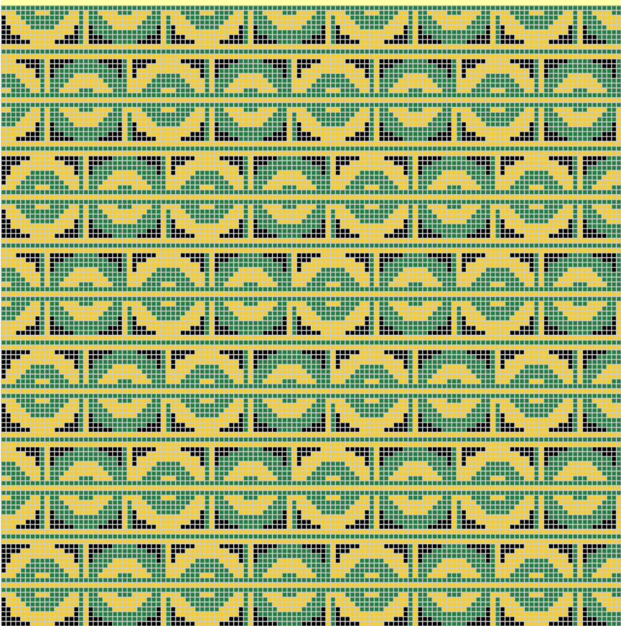
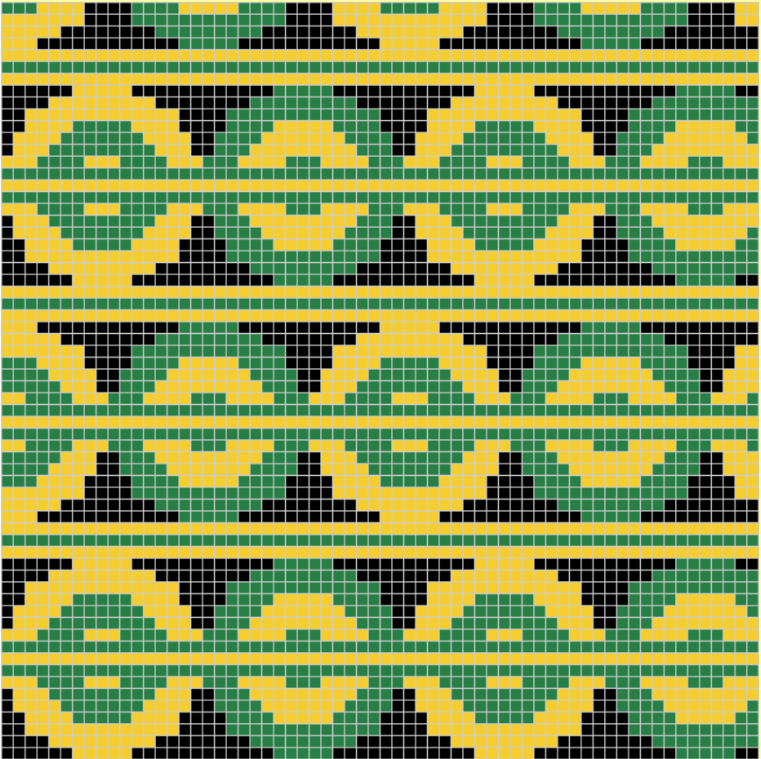
Example
Continued:
Original:

Slide 7
Review Saving in Bricklayer Lite to Teams
Change “Filename” make sure it ends with .xml
Click Download XML
Open up Teams
Open the appropriate folder: ______________________
Click “upload” and select your recently downloaded file
Save
*Move the file to your One Drive from your Downloads folder

Slide 8
Back to Codecademy: www.codecademy.com
Log into your account
Continue with your project in:
“Make a Website”
“Introduction to JavaScript”
Or begin to explore in the following:
“Learn Python”
“Learn Java”
“Learn Rails”

